Slide 1
End Sem Project Presentation
Music Generation
Jerin Joseph - 181210025
Mayank Bhandari - 181210030

Slide 2
Problem Statement
Music Industry provides a wide range of genres, from POP to JAZZ to Classical to Country music. Countless artists including singers, composers, writers, musicians etc., uses a wide variety of instruments to make new music.
It is difficult of people who have other jobs to take their time and learn new instruments in order to create a new music piece.
Musicians and composers needs to be creative and innovate all the time to make create something new.
Why the need for AI generated music?

Slide 3
Problem Statement
Helps people to compose songs by just adjusting the pitch, tempo and allowing the AI to create the music
Inspires composers to create a new masterpiece
Integration with several music applications making it easier for users to compose songs
Why the need for AI generated music?

Slide 4
Motivation
Development in music generation from various companies shows its true potential and what it could achieve in the future.
AIVA, an artificial music generator, released its own copyrighted albums with generated soundtrack in EDM genre
Jukedeck developed an AI music composer which creates its own music which is been trained using deep neural network to understand music at a granular level
Magenta is a python library used to train its pre-built model using different data and convert it to music for its users. It help developers to add the generation model into its music applications.
WaveNet is a speech generation model which predict the next sound by understanding the speech pattern from its input. It uses a type of convolutional neural network

Slide 5
Development Steps
Data Collection
Converting data to input
Model Development and Training
Output
Conversion of output to the required sound format

Slide 6
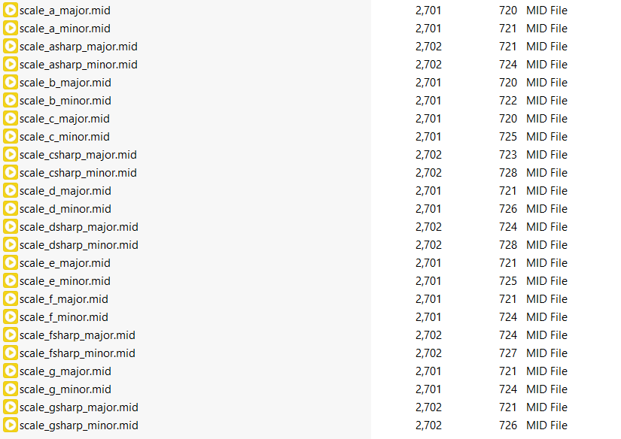
Data Collection
Appropriate Music files should be used for the training of the model.
MIDI files are used for the dataset format.
Basic piano scales and piano classical music are used.
The files are all using the piano instrument and of MIDI format.

Slide 7
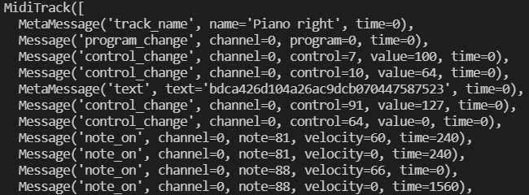
MIDI File
MIDI (Music Instrument Digital Instrument) is a standard protocol used to interact with multiple musical devices to record, synthesize and play music.
Data in MIDI files consist of tracks.
Each track consist of events which tell the note, velocity and the time duration to be played.
Contains additional information like the tempo and resolution.

Slide 8
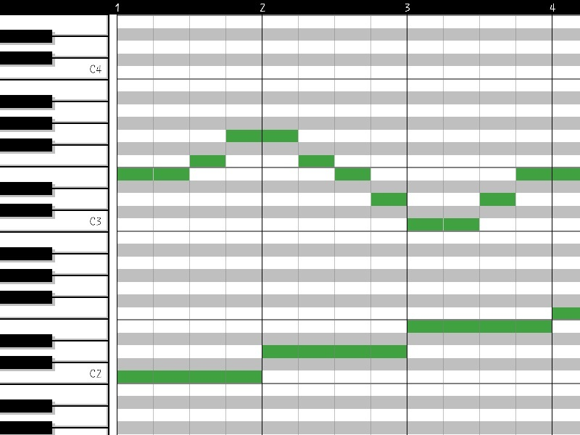
Converting Data to Input
The input will be in the form of a piano roll
Piano Rolls is a format to represent music where y-axis is the notes played and x-axis is the timestamp
Piano Roll will be represented as a matrix (Total Notes x Time) and each cell tell if the note is played or note at a particular interval of time
The piano roll matrix would be converted into sequences for the model

Slide 9
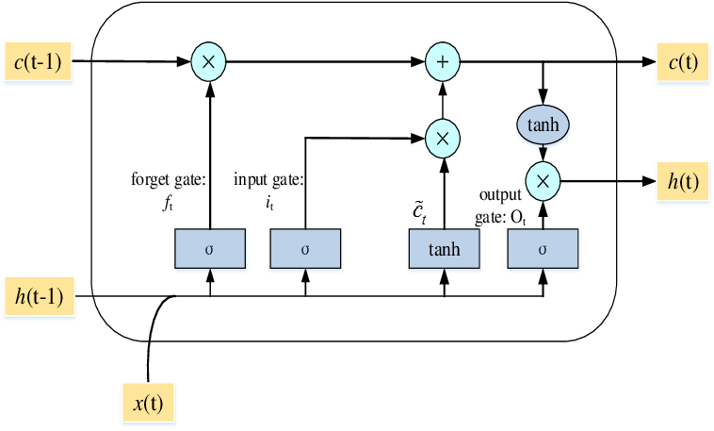
Model Development and Training
Models we considered for this use case are mentioned below.
Wave Net using CNN
Simple RNN
LSTM

Slide 10
Wave Net using CNN
This model is usually used for NLP. This model is based on a type of CNN Model. CNN models are usually used in the field of computer vision and not for audio. Using the original CNN model will not be able to create music efficiently and thus a feedback system is required.
Although this model can be put into use for a variety of complex problems around, but was not able to tackle with our use case, hence we drop this model for further studies.

Slide 11
Simple RNN
While coming across RNN models, we found that they are best suited model for our use case. Digging deeper into it, we come across LSTMs, that uses special units in addition to standard units. So we decided to move with this specialized RNN model named LSTM.

Slide 12
LSTM (Long Short-Term Memory)
RNN models, in general are usually suitable for purposes where a feedback system is required. Music generation highly rests on this concept only, where previous outputs are used for the next input. LSTMs are specialized in this domain, of carrying previous sequences for a longer period of time. This is helpful to produce meaningful music, as new generated music is inspired from the previous notes hit.
The LSTM model has various gates like the forget gate and the input gate which helps to send the previous outputs as feedback.

Slide 13
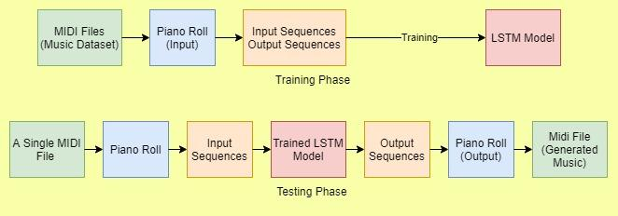
Music Generation Phases

Slide 18
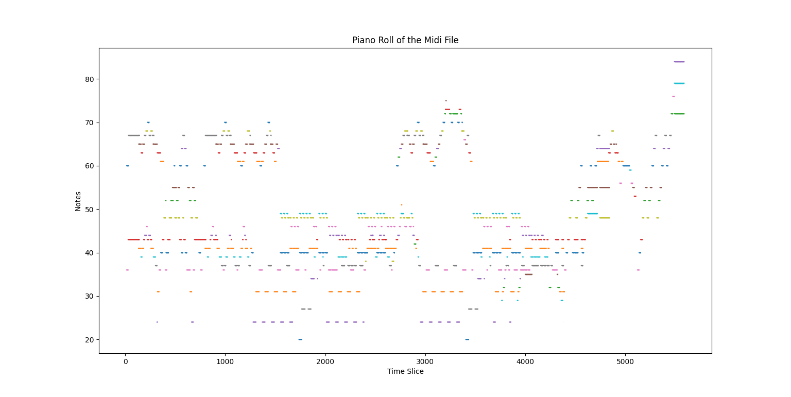
Current Status of Project
Different formats are available like .wav, .mp3, MIDI. We put lot of research on which format is more feasible and logical for our purpose.
If we can convert this format into some logical pattern, something like at which instant of time a particular key is pressed, we can achieve our goal of ideal input.
Eventually MIDI format can be converted into one such format of similar type named Piano Roll.
We created following functions to convert raw data into meaningful input:-
Convert MIDI file to Piano roll.
Convert Piano roll back to MIDI format.
Albeniz classical piano roll

Slide 19
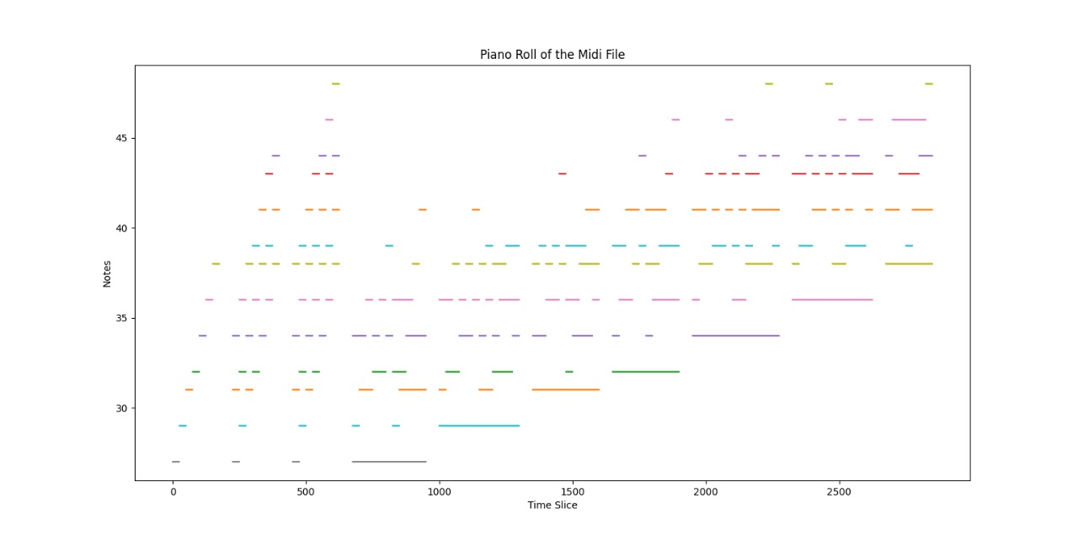
C Major Scale Piano Roll

Slide 20
Future Work and Conclusion
We have our input now, and we have decided to move with LSTM (most meaningful model for our case). So the future works include:-
Training model using input data. This is the backbone of our project as we have to deeply inspect parameter tuning, understanding number of iterations/epochs required to make model perfect (not under-trained to be useless or over-trained to be biased).
Methodology used during training is to split training data into 2 parts:-
1. Input Sequence
2. Output Sequence
It’s like the same that we have X and Y. On feeding X, we should get Y.
Once training is done, we will feed model with unseen data (X) to predict (Y).

Slide 21
The output generated is in Piano roll format, which will be converted back to MIDI format using function created. And this is how AI generated music is created.
The primary focus is definitely on improving model performance which depends upon its training, which again composed of sequence of decisions like parameters tuning, methodology followed, iterations, quality of data and many other factors. But if we are able to achieve the threshold, we will then work towards creating a GUI, which will enable user to interact with the model, and maybe play around with certain extend to create music of his own choice. But this is completely not in priority as of now.

Slide 22
Thank You

